Slide 1
Ecommerce Based Website Online Shopping
Developed By Maisha Maliha

Slide 2
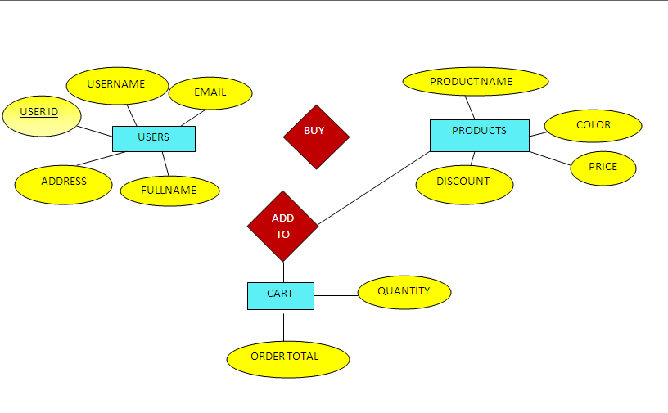
ER DIAGRAM OF ONLINE SHOPPING

Slide 3
INDEPTH DISCUSSION OF THE PROJECT
WHAT TOOLS ARE USED:
Notepad++,Wampserver
WHAT WEB LANGUAGES ARE NEEDED: Html,CSS,Javascript,Bootstrap,MySql,PHP

Slide 4
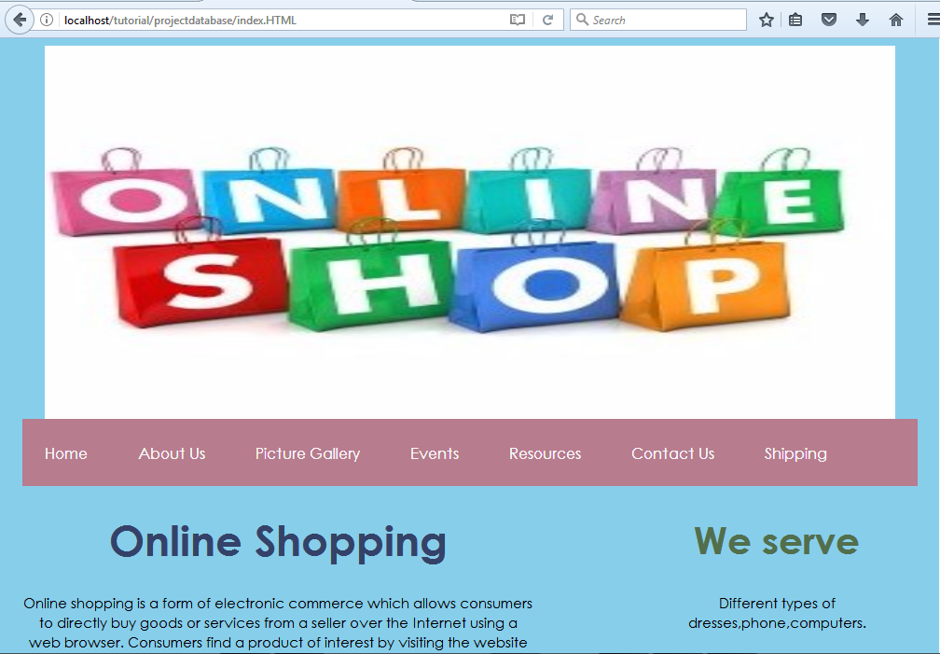
INDEPTH DISCUSSION OF THE PROJECT

Slide 5
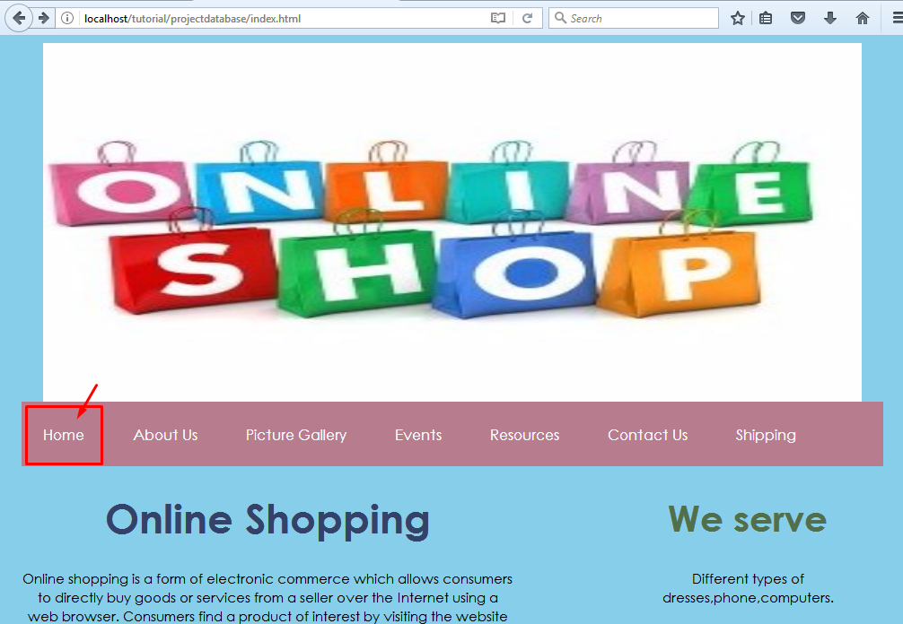
INDEPTH DISCUSSION OF THE PROJECT

Slide 6
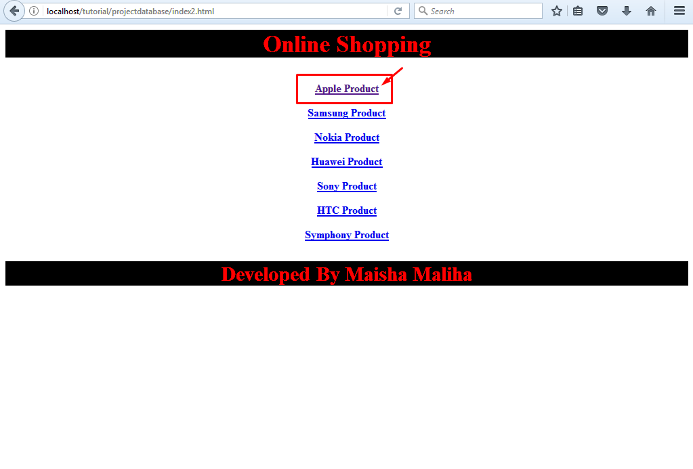
INDEPTH DISCUSSION OF THE PROJECT

Slide 7
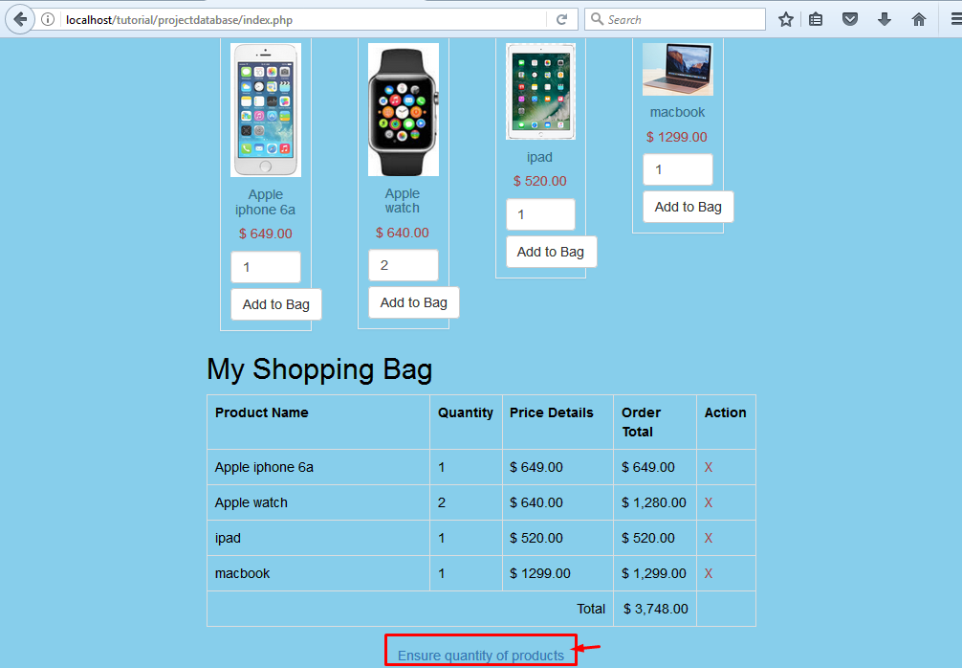
INDEPTH DISCUSSION OF THE PROJECT

Slide 8
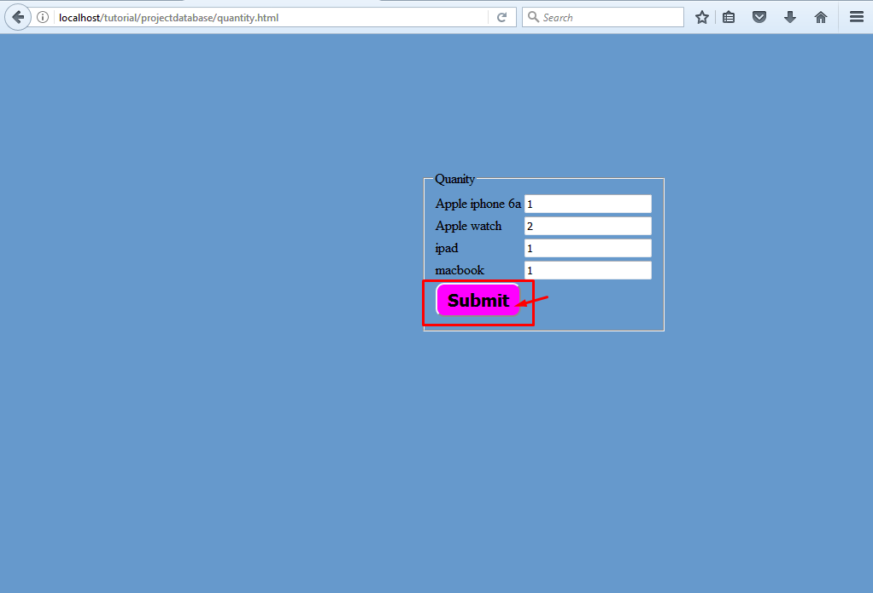
INDEPTH DISCUSSION OF THE PROJECT

Slide 9
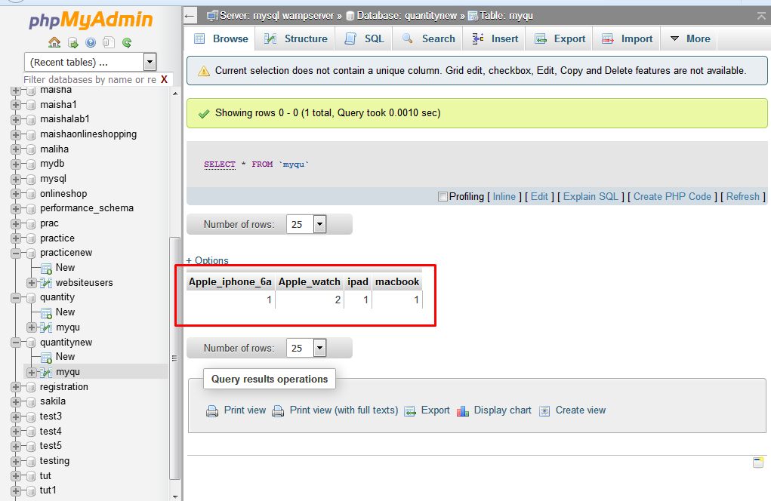
INDEPTH DISCUSSION OF THE PROJECT

Slide 10
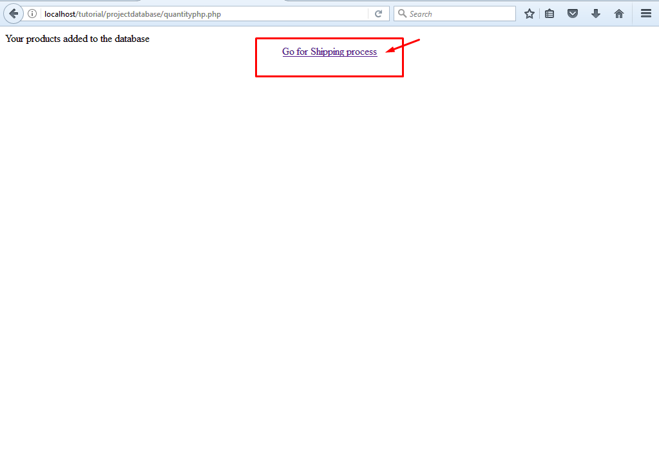
INDEPTH DISCUSSION OF THE PROJECT

Slide 11
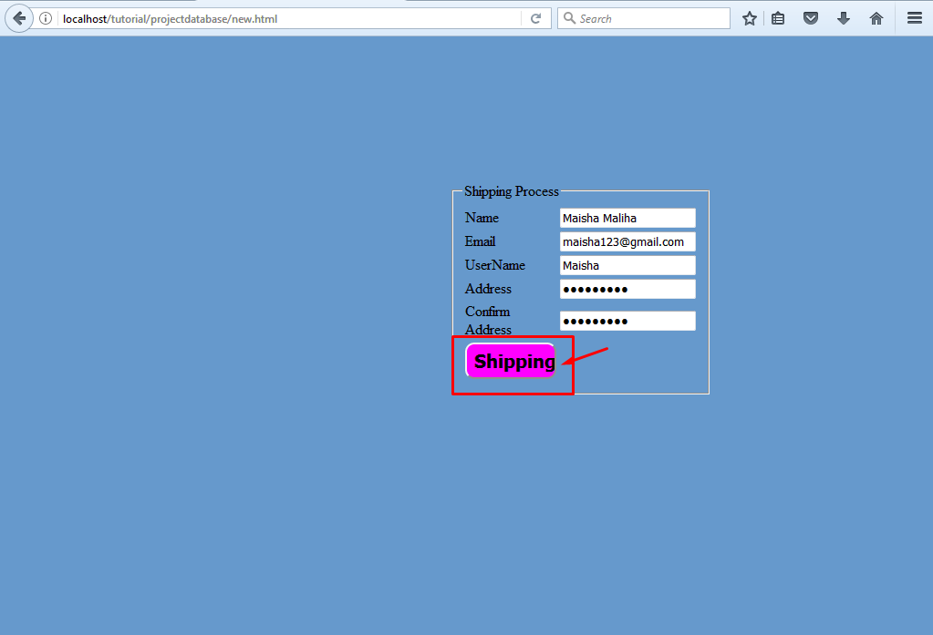
INDEPTH DISCUSSION OF THE PROJECT

Slide 12
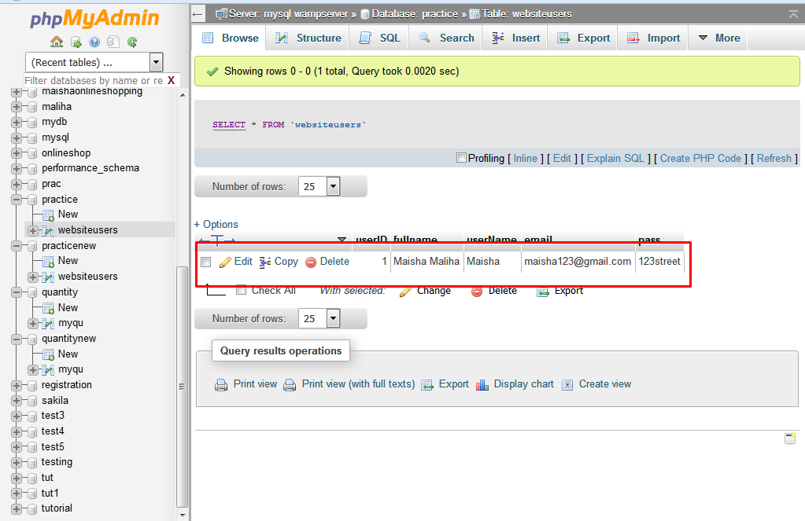
INDEPTH DISCUSSION OF THE PROJECT

Slide 13
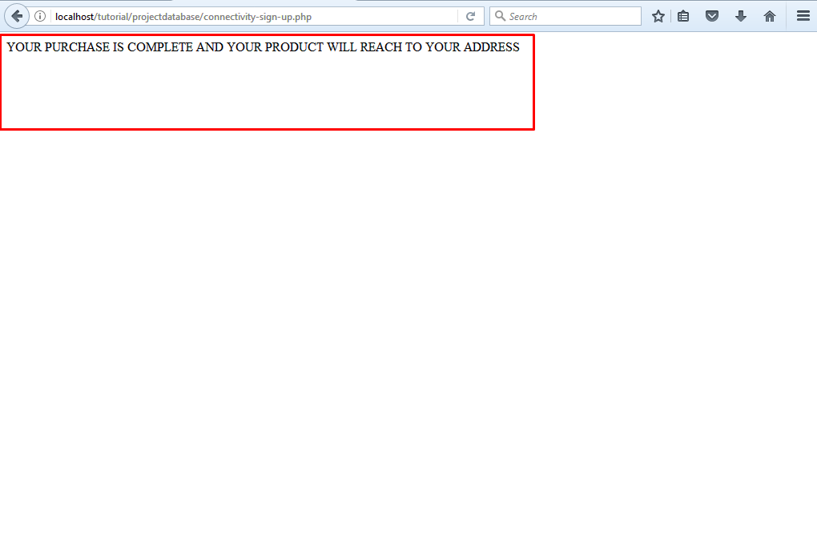
INDEPTH DISCUSSION OF THE PROJECT

